Slide 1
How to Build an IBM Watson assistant chat bot
Using the Socratic Questioning Method, the 4 Key Questions and Bloom’s Taxonomy

Slide 2



MY background
Teacher of Languages | Founder of Girls&BoysinTech and The Language School | CRM Manager | Analyst | Python, NLP & ML and AI enthusiast | GCP, Oracle & IBM Cloud | Mentor @DataEthics4All & @Hackmakers
Github sammyj-w (SammyJ) (github.com)
LinkedIn linkedin.com/in/2020sw
Website the-language-school.weebly.com
Email s.wigglesworth@gmail.com
Girls&BoysinTech

Slide 3
objectives
Gain a basic understanding of Watson Assistant.
Understand the development steps.
Apply design thinking for a cognitive solution.
Create an instance of Watson Assistant
Define intent and dialogs to help natural language processing.
Build a simple Dialogue flow
Translate into another language
A quick overview of Dialogflow from GCP
Notes:
Later tutorials would include:
Use the context object for more advanced dialog.
Develop a hierarchical flow.
Use variables to get data from Watson Assistant.
Use the API.

Slide 4
CHAT BOTS CAN BE DEPLOYED ON E.G.
WORDPRESS
SLACK
FACEBOOK CHAT
EMBEDDED INTO OTHER WEBSITES

Slide 5
Key Questions for building ‘Socratic dialogue’
The 4 Key Questions from my school St Gregory the Great
Socratic Model of Dialectic Questioning
Blooms Taxonomy of questioning
From research carried in the classroom
Curious children

Slide 6
Socratic Model of dialectic questioning - theory
Socrates famously took to the streets of Athens to reason with and question his fellow citizens.
He is associated with the method called ‘Elenchus-refutation’, and conducted his activities by means of questions and answer.
Plato referred to him as a Midwife, who had no ideas of his own but gave birth to them in others.
He used a dialectic techniques like asking citizens questions, or practicing collection and division, or proceeding from hypotheses.
Cross examining a particular position or definition by testing and refuting the speaker.

Slide 7
Aristotle says Socrates’ great contribution was his focus upon definitions and reasoning.
He looked for definitions of terms like justice, virtue, love, piety. He often started with a statement like ‘This generous action is virtuous’, hoping to establish a more important generalization such as ‘all generous actions are virtuous’.
An example of the Socratic dialectic method would be asking the interlocutor to explain what it means to be ‘pious’.
He would not accept an example of piety, but a clear definition, often leading to the realisation that the individual did not know the meaning of the term, only after further probing in the dialogue was an exact definition provided.
Socrates showed the importance of his dialectic method here and the necessity of defining key terms in decision making.

Slide 8
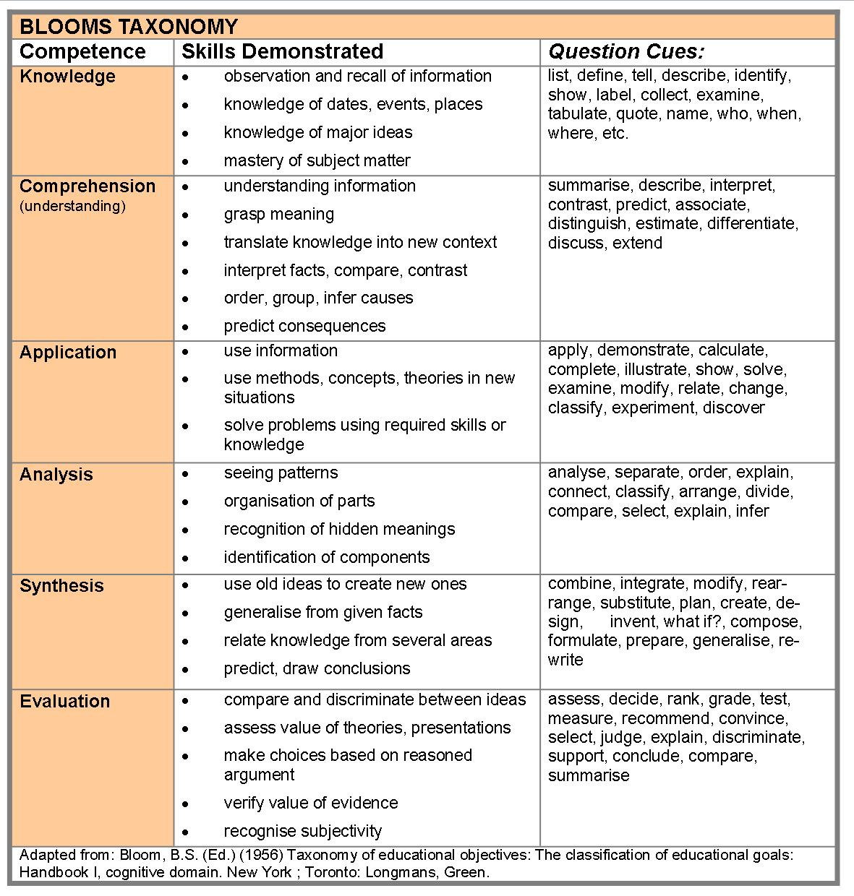
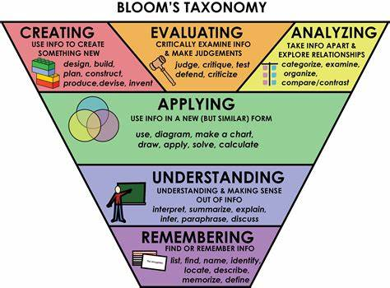

Slide 9
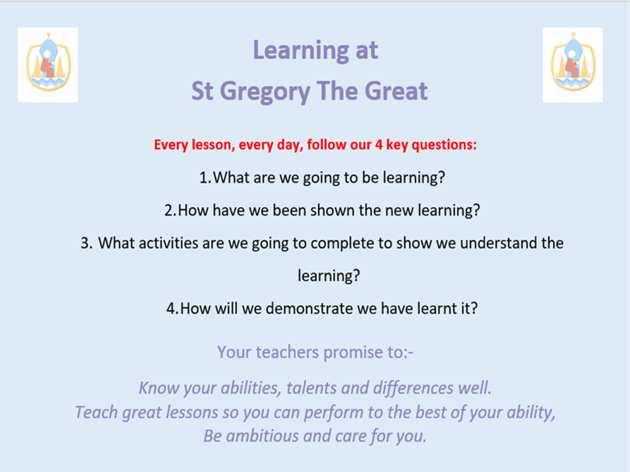

Slide 10
Case study
A teacher wants to modernize the way that the students and the teacher approach questions to their tasks in and outside the classroom. Currently, hundreds of questions are posed and not automated or follow a logical structure to help resolve the a key question or problem statement. Half of the questions are answered at the end of lesson, or take time to elicit, others may not be resolved in the classroom. Those situations result in frustration and a loss of learning time and understanding for the students and teachers.
In this tutorial, you implement a simple Socratic Questioning Dialogflow using IBM Watson chatbot. The chatbot streamlines Classroom questions by automating the dialog flow and quickening up the process.

Slide 11
STEP 1
SIGN UP FOR AN IBM WATSON TRIAL Sign up for a trial.
Notes:
Sign up for IBM Cloud

Slide 12
STEP 2. CREATE THE ASSISTANT
Click Catalog and then click Services > Watson > Assistant.
Launch Watson Assistant. If you're prompted to log in, provide your IBM Cloud credentials.
A new browser tab or window opens and Watson Assistant is displayed.

Slide 13
An assistant named My first assistant is created for you automatically. An assistant is a Chabot. You add skills to your assistant so it can interact with your customers in useful ways.
A dialog skill named My first skill is added to the assistant for you automatically. A dialog skill is a container for the artefacts that define the flow of conversations that your assistant has with your customers.
The dialog skill is opened and the Intents page is displayed.

Slide 14
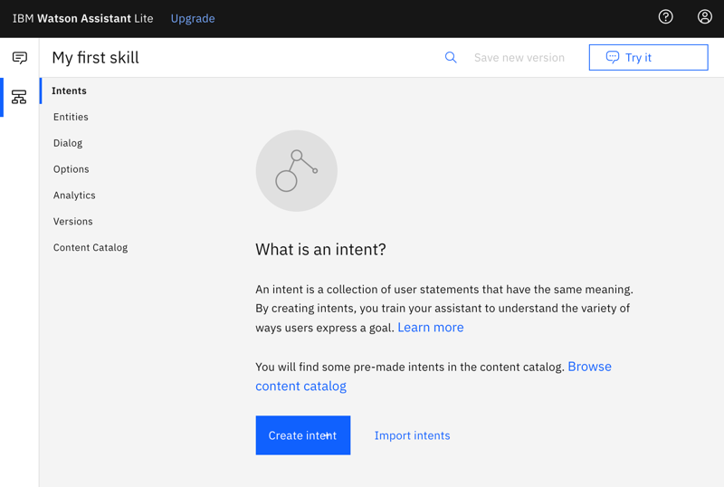

Slide 15
STEP 3. Add intents from a content catalog
The Intents page is where you start to train your assistant. In this tutorial, you will add training data that has been built already to your skill.
Prebuilt intents are available from the content catalog. You will give your assistant access to the General content catalog so your dialog can greet users, and end conversations with them.
Click Content Catalog from the Skills menu.
Find General in the list, and then click Add to skill.

Slide 16
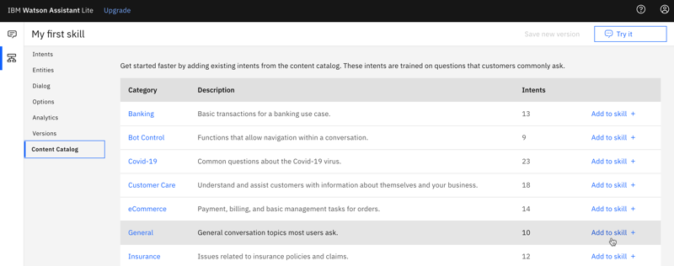

Slide 17
Open the Intents tab to review the intents and associated example utterances that were added to your training data.
You can recognize them because each intent name begins with the prefix #General_. You will add the #General_Greetings and #General_Ending intents to your dialog in the next step.

Slide 18
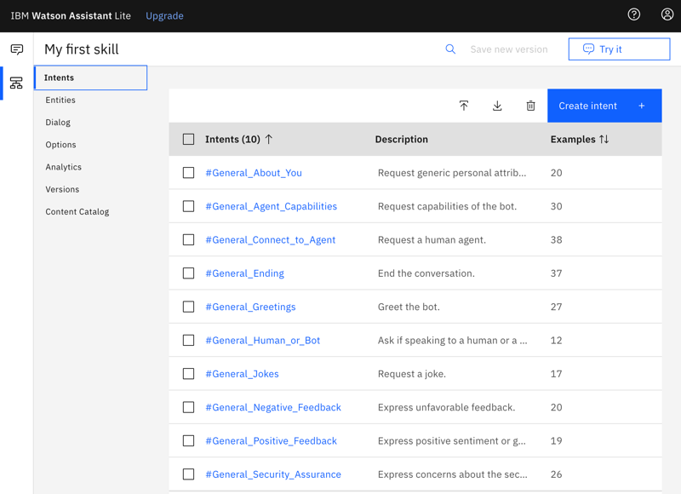
You have successfully started to build your training data by adding prebuilt content from IBM.

Slide 19
The Socratic Questioning intents model
I have pre-built my own Content of Intentions called ‘Socratic Questioning’ which only I will see
I am now going to show you how I did this

Slide 20
Any questions at this point?

Slide 21
Step 4: Build a dialog
A dialog defines the flow of your conversation in the form of a logic tree. It matches intents (what users say) to responses (what your virtual assistant says back).
Each node of the tree has a condition that triggers it, based on user input.
We'll create a simple dialog that handles greeting and ending intents, each with a single node.

Slide 22
Adding a start node
From the Skills menu, click Dialog.
The following two dialog nodes are created for you automatically:
Welcome: Contains a greeting that is displayed to your users when they first engage with the assistant.
Anything else: Contains phrases that are used to reply to users when their input is not recognized.

Slide 23
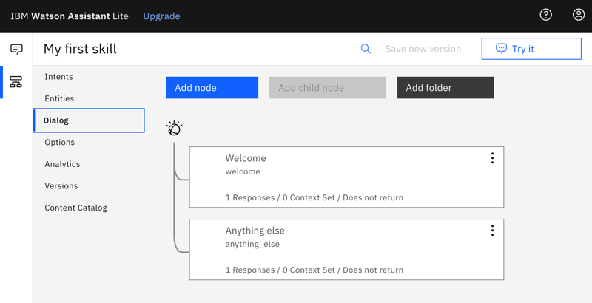

Slide 24
Click the Welcome node to open it in the edit view.
Replace the default response with the text, Welcome to the Watson Assistant tutorial!.

Slide 25
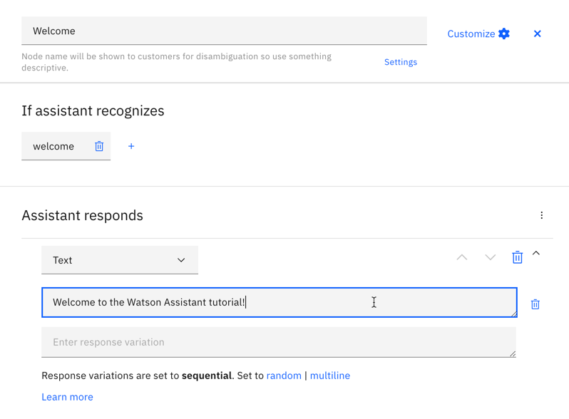

Slide 26
Click X to close the edit view.
You created a dialog node that is triggered by the welcome condition. (welcome is a special condition that functions like an intent, but does not begin with a #.)
It is triggered when a new conversation starts. Your node specifies that when a new conversation starts, the system should respond with the welcome message that you add to the response section of this first node.

Slide 27

Testing the start node
Click the Try it icon to open the "Try it out" pane. You should see your welcome message.
It is located on the top right of the webpage.

Slide 28
Step 5. Adding nodes to handle intents
Now let's add nodes between the Welcome node and the Anything else node that handle our intents.
Click Add node.
In the node name field, type Greet customers.
In the If assistant recognizes field of this node, start to type #General_Greetings. Then, select the #General_Greetings option.
Add the response text, Good day to you!

Slide 29
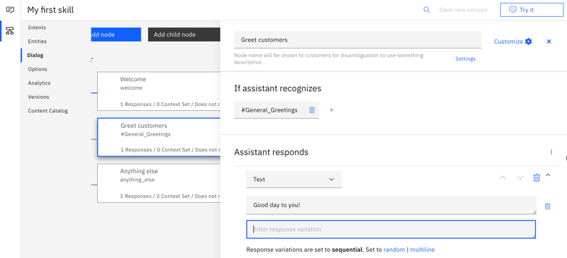

Slide 30
5. Click Close to close the edit view.
6. Click Add node to create a peer node.
7. Name the peer node Say goodbye and specify #General_Ending in the If assistant recognizes field.
8. Add OK. See you later. as the response text.

Slide 31
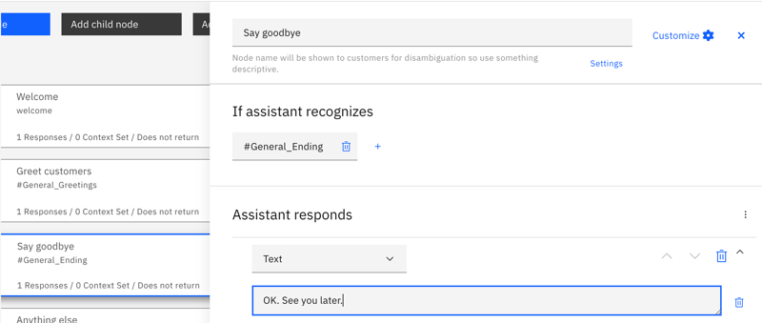

Slide 32
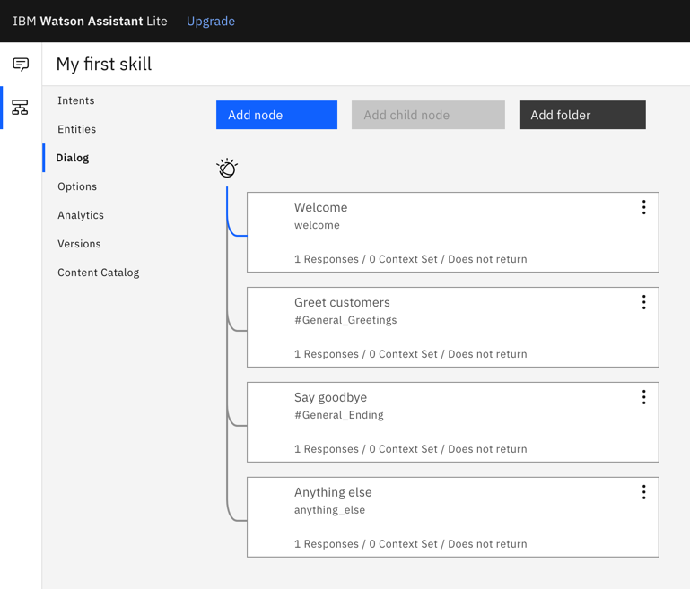
9. Click Close to close the edit view.

Slide 33
STEP 6. Testing intent recognition
You built a simple dialog to recognize and respond to both greeting and ending inputs. Let's see how well it works.

Slide 34
Click the Try it icon to open the "Try it out" pane. There's that reassuring welcome message.
In the text field, type Hello and then press Enter. The output indicates that the #General_Greetings intent was recognized, and the appropriate response (Good day to you.) is displayed.
Try the following input:
bye
howdy
see ya
good morning
sayonara

Slide 35
4. Watson can recognize your intents even when your input doesn't exactly match the examples that you included. The dialog uses intents to identify the purpose of the user's input regardless of the precise wording used, and then responds in the way you specify.

Slide 36
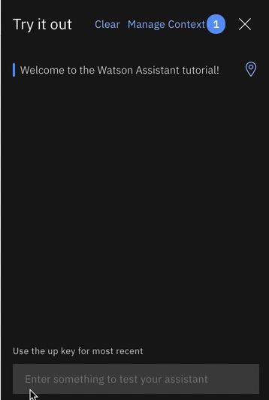
Result of building a dialog
That's it. You created a simple conversation with two intents and a dialog to recognize them.
Video demo of the example we built

Slide 37
Step 7: Integrate the assistant
Now that you have an assistant that can participate in a simple conversational exchange, test it.
Click the Assistants icon Assistants menu icon to open a list of your assistants.
Find the My first assistant, and open it.
Test your assistant with a Preview link integration.
The Preview link integration is created for your automatically. It builds your assistant into a chat widget that is hosted by an IBM-branded web page. You can open the web page and chat with your assistant to test it out.
From the Integrations section, click the Preview link tile.

Slide 38
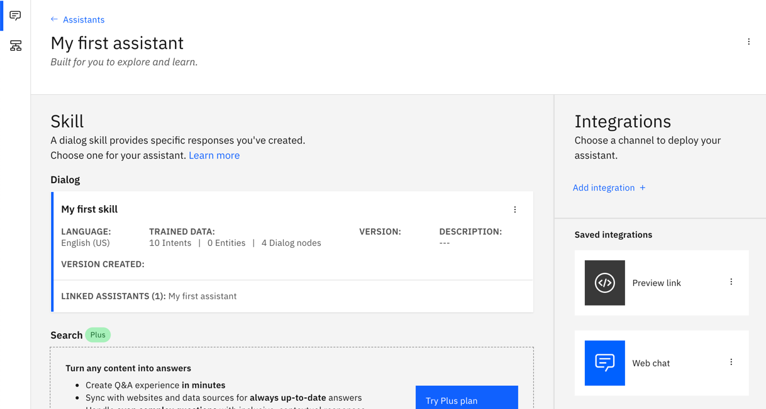

Slide 39
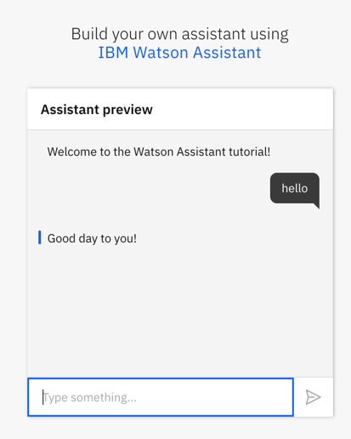
IBM Watson Assistant
6. Click the URL that is displayed on the page.
The test web page opens in a new tab. You can start submitting message to see how your assistant responds.
7. Type hello into the text field, and watch your assistant respond.
Notes:
With a Lite plan, you can use the service for free. With other plans, you are charged for messages that you submit from the preview link integration. You can review metrics about the test user conversations from the Analytics page. You are not charged for messages that you submit from the "Try it out" pane, and the exchanges you have there are not logged.

Slide 40
You can share the URL with others who might want to try out your assistant.
8. After testing, close the web page. Click the X to close the preview link integration page.

Slide 41
Next steps
This tutorial is built around a simple example.
For a real application, you need to define some more interesting intents, some entities, and a more complex dialog that uses them both. When you have a polished version of the assistant, you can integrate it with web sites or channels, such as Slack, that your customers already use. As traffic increases between the assistant and your customers, you can use the tools that are provided in the Analytics page to analyze real conversations, and identify areas for improvement.

Slide 42
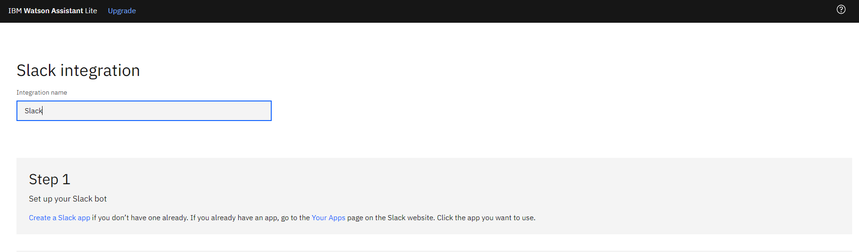
SLACK INTEGRATION
NB: YOU MUST REQUEST PERMISSION FROM SLACK CHANNEL ADMIN TO GAIN ACCESS TO YOUR CHATBOT

Slide 43
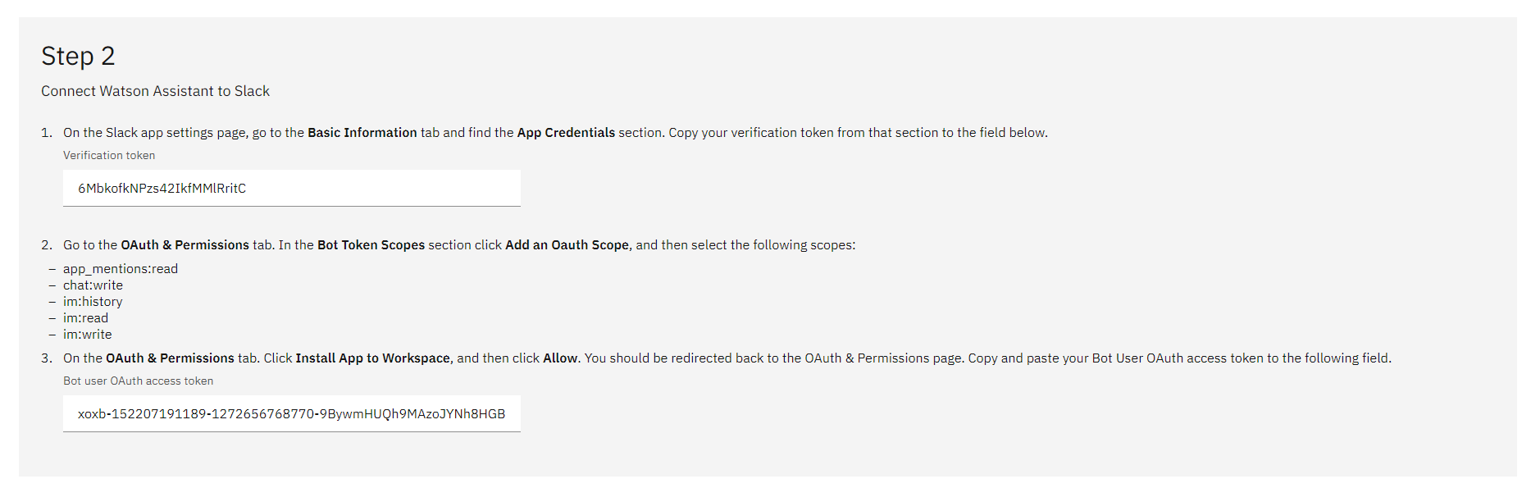
Slack | Manage Apps | Cloud Services @ IBM
Notes:
Slack API: Applications | Cloud Services @ IBM Slack
-- Build → authentication →

Slide 44
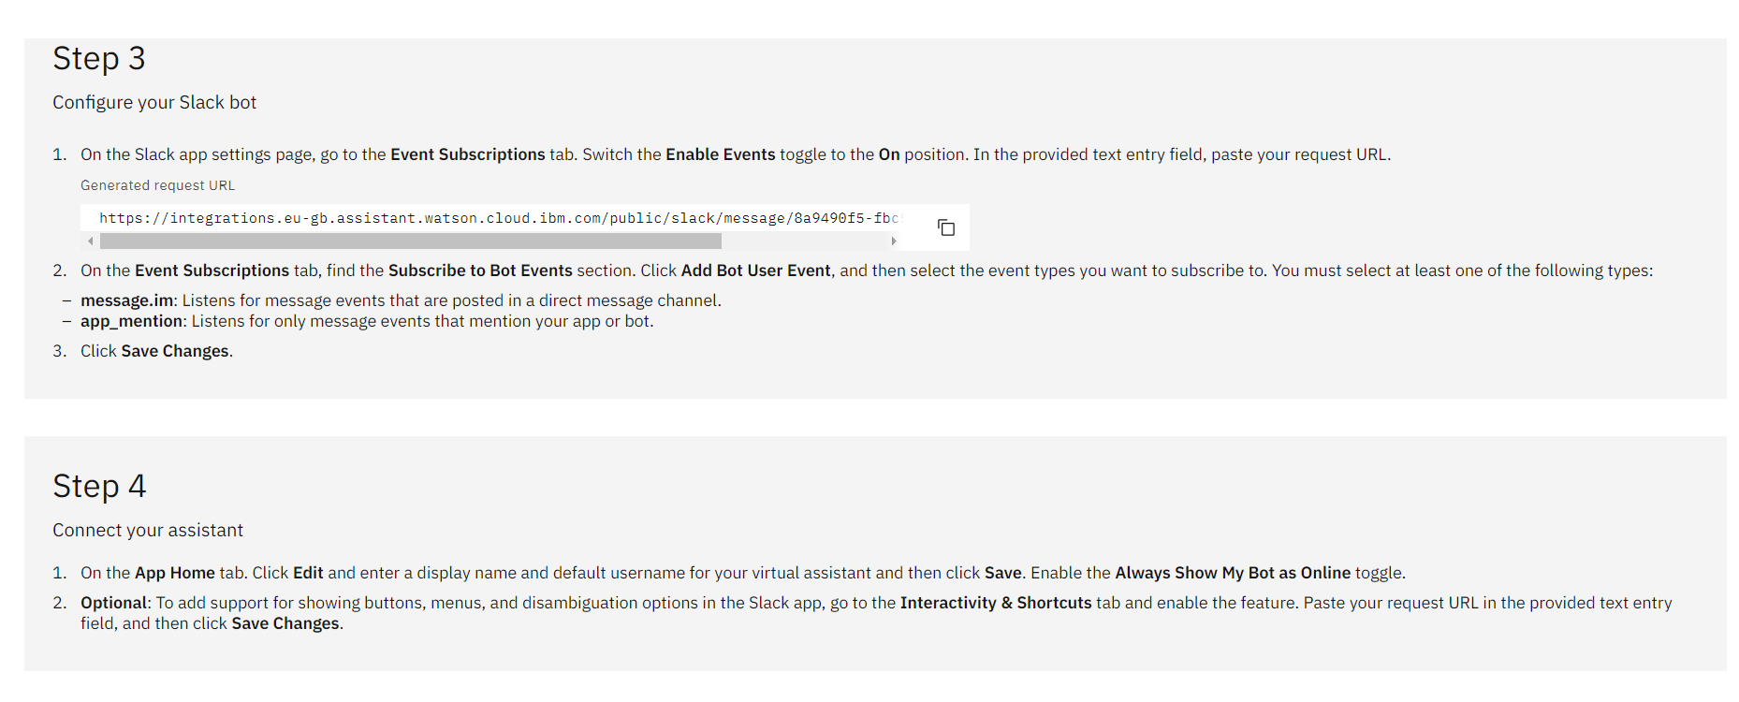

Slide 45
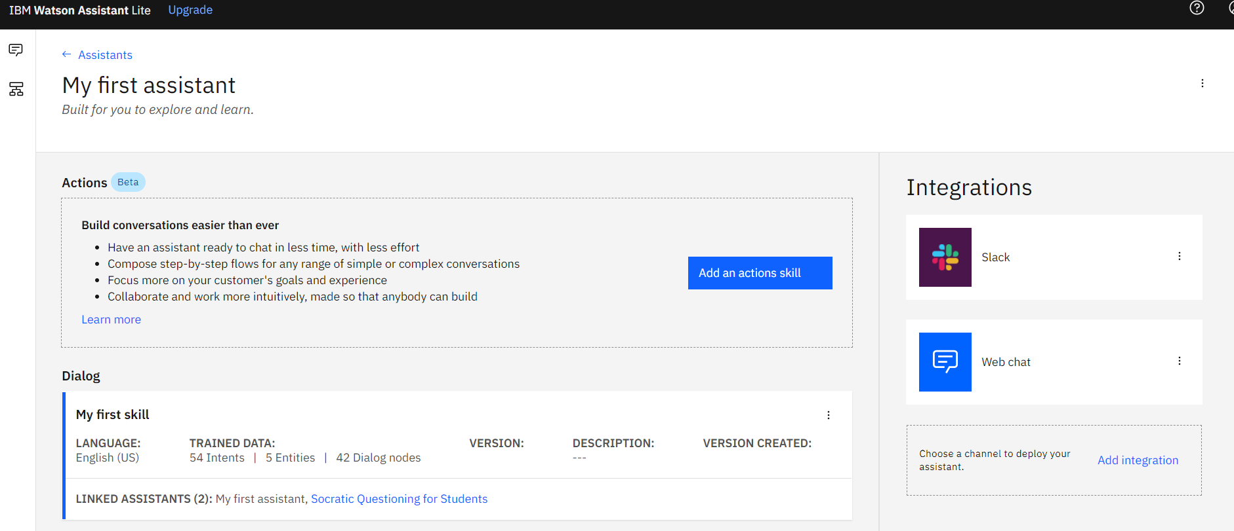
CONNECTING TO FACEBOOK
You can integrate your Chat Bot to Facebook by choosing the Facebook option in the Integrations section.
1. click on the ‘Add Integrations’ button under the Integrations section in My First Assistant, and connect up your Facebook account.

Slide 46
INTEGRATING IT ONTO YOUR WEBSITE
You can embed the code to your website for the Chat Bot once it is completed.
1.Click on the ‘Web chat’ Integration icon to test and build the code into your website, located under the Integrations list in My First Assistant.

Slide 47
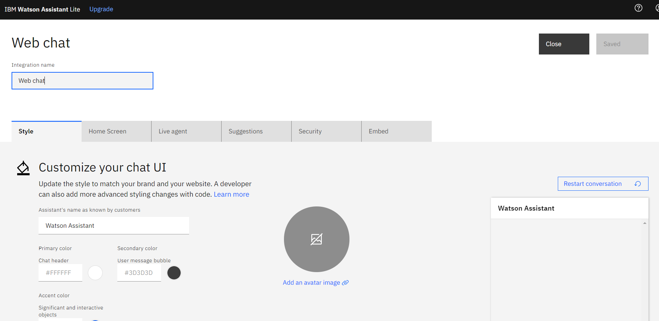
2. Here you can modify the style, home screen and embed your chatbot, if you cannot resolve a query you can also connect the webchat feature to a live agent.

Slide 48

ALTERNATIVE CHATBOT TOOLS
GCP’s DialogFlow is available as an API in the Google Cloud Console API Library.
Dialogflow API – APIs & Services – My Project 7734 – Google Cloud Platform

Slide 49
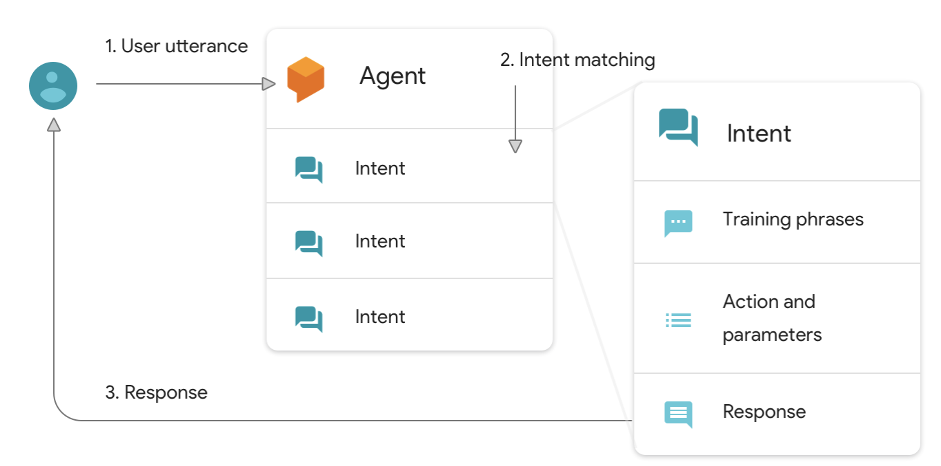
Dialog flow MODEL from GCP

Slide 50
REFERENCES
Getting started with Watson Assistant (ibm.com)
https://cloud.ibm.com/docs/assistant?topic=assistant-getting-started
“A Socratic Model of dialectic questioning” (Babalola A., 2020)

Slide 51
Thank you for attending this bootcamp
Do you have any further questions?
Github sammyj-w (SammyJ) (github.com)
LinkedIn linkedin.com/in/2020sw
Website the-language-school.weebly.com
Email s.wigglesworth@gmail.com

